Slide 1
Chapter 22: Object-Based Databases

Slide 2
Chapter 22: Object-Based Databases
Object-Relational Data Models
Complex Data Types and Object Orientation
Structured Data Types and Inheritance in SQL
Table Inheritance
Array and Multiset Types in SQL
Object Identity and Reference Types in SQL
Implementing O-R Features
Persistent Programming Languages
Comparison of Object-Oriented and Object-Relational Databases

Slide 3
Object-Relational Data Models
Advanced Database Applications need Complex Data Types
Two approaches:
  Object-Oriented Databases
  Object-Relational Databases
Object-Relational Data Model:
  Extend the relational data model by including object orientation and constructs to deal with added data types.
Allow attributes of tuples to have complex types, including non-atomic values such as nested relations.
Preserve relational foundations, in particular the declarative access to data, while extending modeling power.
Upward compatibility with existing relational languages.

Slide 4
Complex Data Types
Motivation:
  Permit non-atomic domains (atomic ≡ indivisible)
  Example of non-atomic domain: set of integers,or set of tuples
  Allows more intuitive modeling for applications with complex data
Intuitive definition:
  allow relations whenever we allow atomic (scalar) values — relations within relations
  Retains mathematical foundation of relational model
  Violates first normal form.

Slide 5
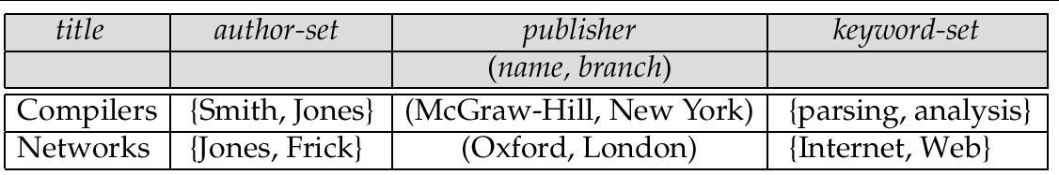
Example of a Nested Relation
Example: library information system
Each book has
  title,
  a set of authors,
  Publisher, and
  a set of keywords
Non-1NF relation books

Slide 6
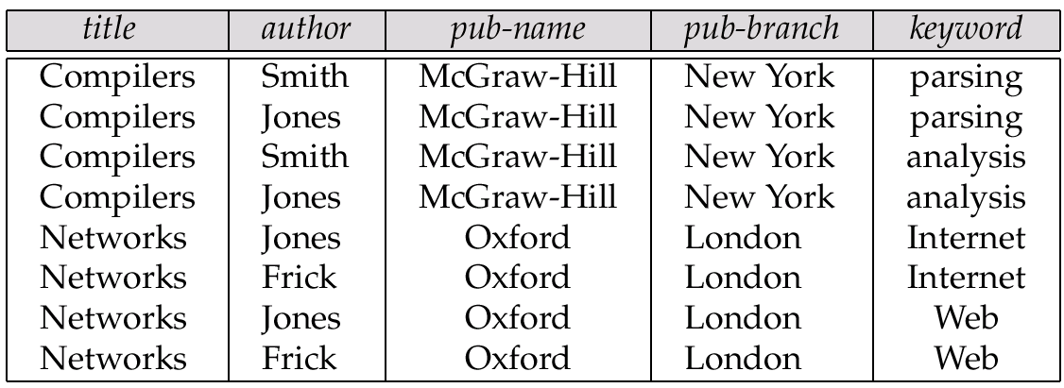
1NF Version of Nested Relation
1NF version of books
flat-books

Slide 7
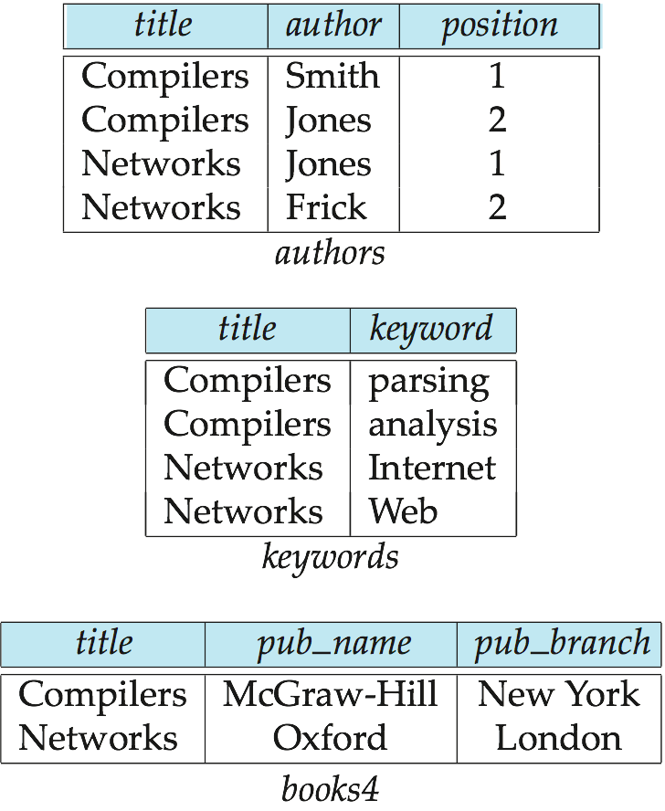
4NF Decomposition of Nested Relation
Remove awkwardness of flat-books by assuming that the following multivalued dependencies hold:
  title author
  title keyword
  title pub-name, pub-branch
Decompose flat-doc into 4NF using the schemas:
  (title, author )
  (title, keyword )
  (title, pub-name, pub-branch )

Slide 8
Problems with 4NF Schema
4NF design requires users to include joins in their queries.
1NF relational view flat-books defined by join of 4NF relations:
  eliminates the need for users to perform joins,
  but loses the one-to-one correspondence between tuples and documents.
  And has a large amount of redundancy
Nested relations representation is much more natural here.

Slide 9
Complex Types and SQL:1999
Extensions to SQL to support complex types include:
  Collection types
    Nested relations are an example of collection types
  Structured types
    Nested record structures like composite attributes
  Inheritance
  Object orientation
    Including object identifiers and references
  Large object types
    BLOB, CLOB
Our description is mainly based on the SQL:1999 standard
  Not fully implemented in any database system currently
  But some features are present in each of the major commercial database systems
    Read the manual of your database system to see what it supports

Slide 10
Structured Types and Inheritance in SQL
Structured types can be declared and used in SQL
create type Name as
(firstname varchar(20),
lastname varchar(20))
final
create type Address as
(street varchar(20),
city varchar(20),
zipcode varchar(20))
not final
  Note: final and not final indicate whether subtypes can be created
Structured types can be used to create tables with composite attributes
create table customer (
name Name,
address Address,
dateOfBirth date)
Dot notation used to reference components: name.firstname

Slide 11
Structured Types (cont.)
User-defined row types with methods declaration:
  create type CustomerType as (
  name Name,
  address Address,
  dateOfBirth date，
method ageOnDate (onDate date)
returns interval year
  ) not final
Can then create a table whose rows are a user-defined type
  create table customer of CustomerType

Slide 12
Methods（方法）
  Method body is given separately.
  create instance method ageOnDate (onDate date)
  returns interval year
  for CustomerType
  begin
  return onDate - self.dateOfBirth;
  end
We can now find the age of each customer:
  select name.lastname, ageOnDate (current_date)
  from customer

Slide 13
Constructor Functions（构造函数）
Constructor functions are used to create values of structured types
E.g.
create function Name(firstname varchar(20), lastname varchar(20))
returns Name
begin
set self.firstname = firstname;
set self.lastname = lastname;
end
To create a value of type Name, we use
new Name(‘John’, ‘Smith’)
Normally used in insert statements
insert into Person values
(new Name(‘John’, ‘Smith),
new Address(’20 Main St’, ‘New York’, ‘11001’),
date ‘1960-8-22’);

Slide 14
Type Inheritance
Suppose that we have the following type definition for people:
create type Person
(name varchar(20),
address varchar(20))
Using inheritance to define the student and teacher types
create type Student
under Person
(degree varchar(20),
department varchar(20))
create type Teacher
under Person
(salary integer,
department varchar(20))
Subtypes can redefine methods by using overriding method in place of method in the method declaration

Slide 15
Table Inheritance
Tables created from subtypes can further be specified as subtables
E.g. create table people of Person;
create table students of Student under people;
create table teachers of Teacher under people;
Tuples added to a subtable are automatically visible to queries on the supertable
  E.g. query on people also sees students and teachers.
  Similarly updates/deletes on people also result in updates/deletes on subtables

Slide 16
Array and Multiset Types in SQL
Example of array and multiset declaration:
create type Publisher as
(name varchar(20),
branch varchar(20))
create type Book as
(title varchar(20),
author-array varchar(20) array [10],
pub-date date,
publisher Publisher,
keyword-set varchar(20) multiset )
create table books of Book
Similar to the nested relation books, but with array of authors
instead of set

Slide 17
Creation of Collection Values
Array construction
array [‘Silberschatz’,`Korth’,`Sudarshan’]
Multisets
  multiset [‘computer’, ‘database’, ‘SQL’]
To create a tuple of the type defined by the books relation: (‘Compilers’, array[`Smith’,`Jones’],
Publisher (`McGraw-Hill’,`New York’), multiset [`parsing’,`analysis’ ])
To insert the preceding tuple into the relation books
insert into books
values
(‘Compilers’, array[`Smith’,`Jones’],
Publisher (`McGraw-Hill’,`New York’), multiset [`parsing’,`analysis’ ])

Slide 18
Querying Collection-Valued Attributes
We can access individual elements of an array by using indices
  E.g.: If we know that a particular book has three authors, we could write:
select author-array[1], author-array[2], author-array[3]
from books
where title = `Database System Concepts’

Slide 19
Querying Collection-Valued Attributes
To find all books that have the word “database” as a keyword,
select title
from books
where ‘database’ in (unnest(keyword-set ))

Slide 20
Querying Collection-Valued Attributes
To get a relation containing pairs of the form “title, author-name” for each book and each author of the book
select B.title, A.author
from books as B, unnest (B.author-array) as A (author )
To retain ordering information we add a with ordinality clause
select B.title, A.author, A.position
from books as B, unnest (B.author-array) with ordinality as
A (author, position )

Slide 21
Unnesting(展开嵌套)
The transformation of a nested relation(collection-valued attribute) into a form with fewer (or no) relation-valued attributes is called unnesting.
E.g.
select title, A.author, publisher.name as pub_name,
publisher.branch as pub_branch, K.keyword
from books as B, unnest(B.author_array ) as A (author ),
unnest (B.keyword_set ) as K (keyword )

Slide 22
1NF Version of Nested Relation
1NF version of books
flat-books

Slide 23
Object-Identity and Reference Types
Define a type Department with a field name and a field head which is a reference to the type Person, with table people as scope:
create type Department (
name varchar (20),
head ref (Person) scope people)
We can then create a table departments as follows
create table departments of Department

Slide 24
Initializing Reference-Typed Values
To create a tuple with a reference value, we can first create the tuple with a null reference and then set the reference separately:
insert into departments
values (`CS’, null)
update departments
set head = (select p.person_id
from people as p
where name = `John’)
where name = `CS’

Slide 25
Object-Identity and Reference Types
References are deferenced is SQL:1999 by the -> symbol.
select head->name, head->salary
from departments;
deref() returns the tuple pointed to by a reference .
select deref(head).name
from departments;

Slide 26
End of Chapter 22

